Slide 1

Data Mining
Recommendation Systems
İnanç Arın

Slide 2
Reference
The following slides are from the “Mining of Massive Datasets” course by
  Jure Leskovec, Anand Rajaraman, Jeff Ullman
  Stanford
  http://www.mmds.org/
2

Slide 3
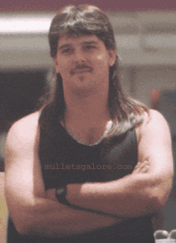
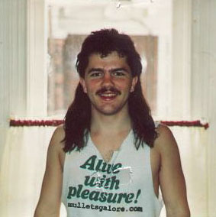
Example: Recommender Systems
Customer X
  Buys Metallica CD
  Buys Megadeth CD
Customer Y
  Does search on Metallica
  Recommender system suggests Megadeth from data collected about customer X

Slide 4











Recommendations
Examples:
Search
Recommendations
Items
Products, web sites,
blogs, news items, …

Slide 5
From Scarcity to Abundance
Shelf space is a scarce commodity for traditional retailers
  Also: TV networks, movie theaters,…
Web enables near-zero-cost dissemination
of information about products
  From scarcity to abundance
More choice necessitates better filters
  Recommendation engines
  How Into Thin Air made Touching the Void
  a bestseller: http://www.wired.com/wired/archive/12.10/tail.html
Notes:
In 1988, a British mountain climber named Joe Simpson wrote a book called Touching the Void, a harrowing account of near death in the Peruvian Andes. It got good reviews but, only a modest success, it was soon forgotten. Then, a decade later, a strange thing happened. Jon Krakauer wrote Into Thin Air, another book about a mountain-climbing tragedy, which became a publishing sensation. Suddenly Touching the Void started to sell again.
Random House rushed out a new edition to keep up with demand. Booksellers began to promote it next to their Into Thin Air displays, and sales rose further. A revised paperback edition, which came out in January, spent 14 weeks on the New York Times bestseller list. That same month, IFC Films released a docudrama of the story to critical acclaim. Now Touching the Void outsells Into Thin Air more than two to one.
What happened? In short, Amazon.com recommendations. The online bookseller's software noted patterns in buying behavior and suggested that readers who liked Into Thin Air would also like Touching the Void. People took the suggestion, agreed whole heartedly, wrote rhapsodic reviews. More sales, more algorithm-fueled recommendations, and the positive feedback loop kicked in.

Slide 6
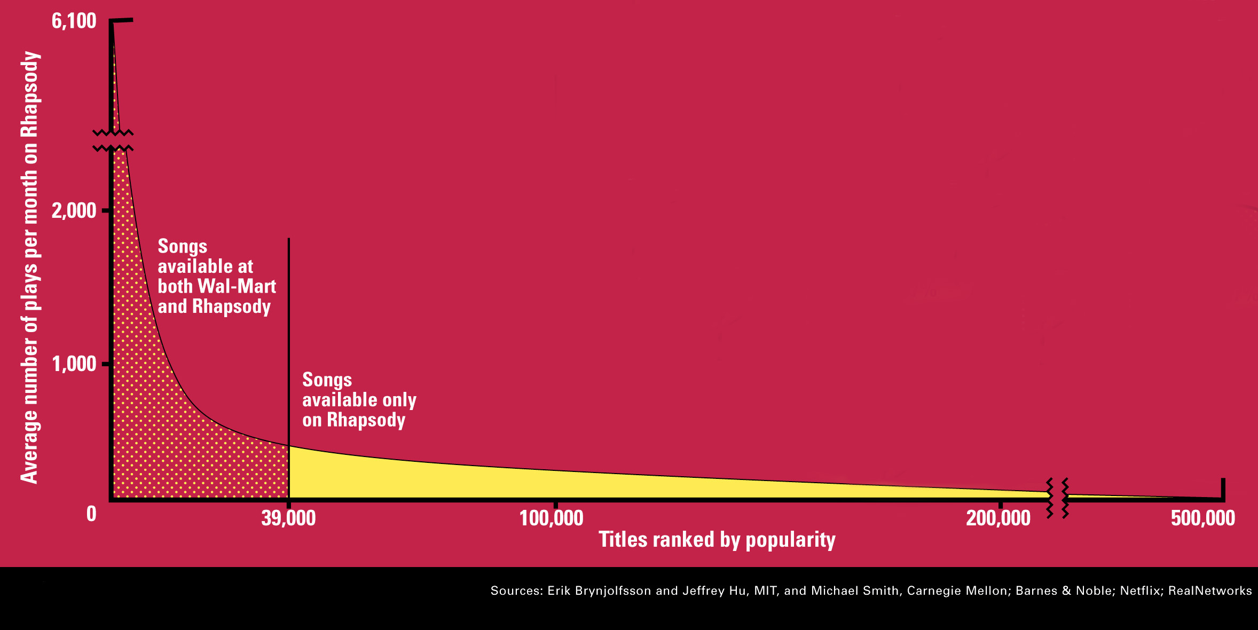
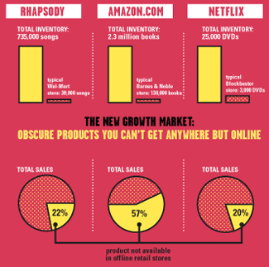
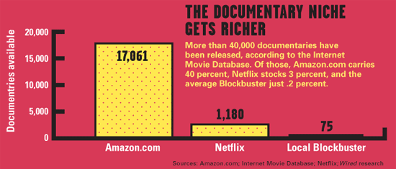
Sidenote: The Long Tail
Source: Chris Anderson (2004)

Slide 7
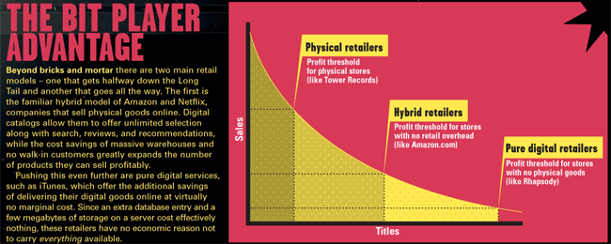
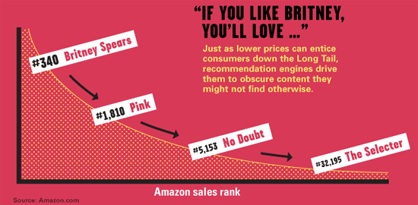
Physical vs. Online
    Read http://www.wired.com/wired/archive/12.10/tail.html to learn more!

Slide 8
The Netflix 1M Dollar Prize
“The algorithm had to have a root-mean-square error (RMSE) that was 10% less than the RMSE of the Netflix algorithm on a test set taken from actual ratings of Netflix users. To develop an algorithm, contestants were given a training set of data, also taken from actual Netflix data.”
http://infolab.stanford.edu/~ullman/mmds/ch9.pdf
The prize was finally won in 2009 (after three years) by “Bellkor’s Pragmatic Chaos”
http://infolab.stanford.edu/~ullman/mmds/ch9.pdf
8

Slide 9
Types of Recommendations
Editorial and hand curated
  List of favorites
  Lists of “essential” items
Simple aggregates
  Top 10, Most Popular, Recent Uploads
Tailored to individual users
  Amazon, Netflix, …

Slide 10
Formal Model
X = set of Customers
S = set of Items
Utility function u: X × S → R
  R = set of ratings
  R is a totally ordered set
  e.g., 0-5 stars, real number in [0,1]

Slide 11
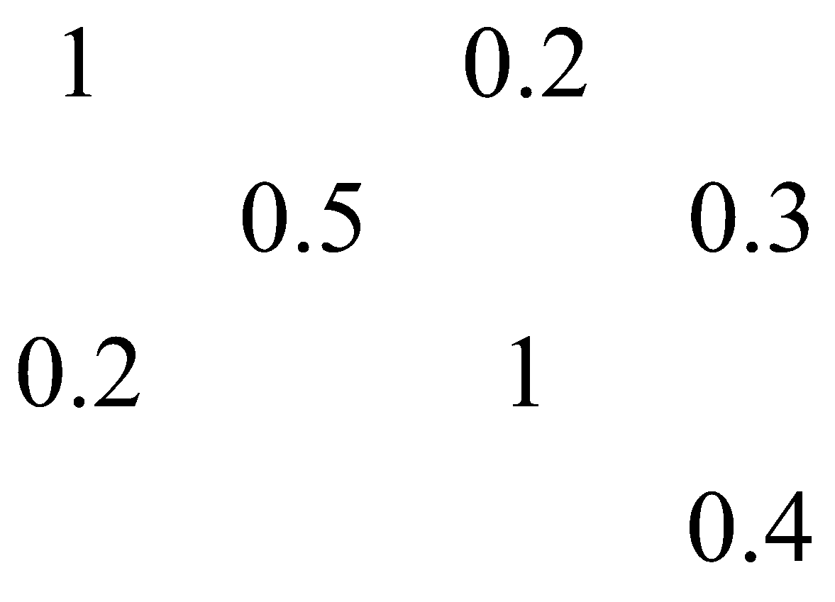
Utility Matrix
Avatar
LOTR
Matrix
Pirates
Alice
Bob
Carol
David

Slide 12
Basic Methodologies
Content based filtering
  Looks into the properties of the items
  Ex: Those who bought books of certain topic are in interested in books of same type
Collaborative Filtering
  Looks into similarity of users and items
  Similar users are interested in similar items
12

Slide 13
Data Mining Methods/Tools
For Recommensation Systems
Similarity
  Similarity of items (books, documents, images, music)
Clustering
  Cluster Users based on their behaviour
Classification
  Try to predict what the user will like
13

Slide 14
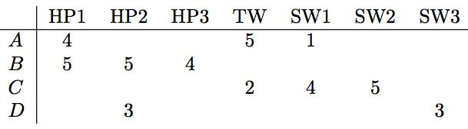
From Raw Data to Utility Matrix
http://infolab.stanford.edu/~ullman/mmds/ch9.pdf
http://infolab.stanford.edu/~ullman/mmds/ch9.pdf
Problem of sparsity
  Lots of entries are empty
  In practice only a small fraction of the entries are known
Task of a recommendation system
  Predict the blanks
  Is user A interested in HP2?
14

Slide 15
Methodology
http://infolab.stanford.edu/~ullman/mmds/ch9.pdf
Content based filtering
  If user liked HP1, since HP2 is a similar movie, he/she will also like it
Collaborative Filtering
  If we know that people who usually like HP1 also like HP2 then we can say A will like HP2
Goal is to try to find items that will be highly preferred by users
15

Slide 16
Key Problems
(1) Gathering “known” ratings for matrix
  How to collect the data in the utility matrix
(2) Extrapolate unknown ratings from the
known ones
  Mainly interested in high unknown ratings
    We are not interested in knowing what you don’t like
    but what you like
(3) Evaluating extrapolation methods
  How to measure success/performance of
  recommendation methods

Slide 17
(1) Gathering Ratings
Explicit
  Ask people to rate items
  Doesn’t work well in practice – people
  can’t be bothered
Implicit
  Learn ratings from user actions
    E.g., purchase implies high rating
  What about low ratings?

Slide 18
(2) Extrapolating Utilities
Key problem: Utility matrix U is sparse
  Most people have not rated most items
  Cold start:
    New items have no ratings
    New users have no history
Main approaches to recommender systems:
  1) Content-based
  2) Collaborative
  3) Latent factor based algorithms

Slide 19
Content-based Recommendations
Main idea: Recommend items to customer x similar to previous items rated highly by x
Example:
Movie recommendations
  Recommend movies with same actor(s),
  director, genre, …
Websites, blogs, news
  Recommend other sites with “similar” content

Slide 20
Plan of Action
Item profiles
likes
build
recommend
match
Red
Circles
Triangles
User profile

Slide 21
Content based recommendation: Item Profiles
Item profiling with features
  Movie: Actors, Director, Genre ….
http://infolab.stanford.edu/~ullman/mmds/ch9.pdf
21

Slide 22
Item Profiles
For each item, create an item profile
Profile is a set (vector) of features
  Movies: author, title, actor, director,…
  Text: Set of “important” words in document

Slide 23
Constructing the Utility Matrix
Ask users to do rating
Make inferences from users’ behavior
  If user watches or buys, then it means the user likes the item
  1 means user liked
  0 means user did not watch or buy
http://infolab.stanford.edu/~ullman/mmds/ch9.pdf
23

Slide 24

Content based recommendation: Item Profiles
Features of multiple types
  Boolean features. Ex: Movie has actors, director, genre
  Numeric features. Ex: Rating for a movie, screen size, disc capacity
  Cosine similarity still works for mix of Boolean and numeric features
24

Slide 25
Content based recommendation: User Profiles
Constructing vectors describing user preferences
Aggregate the items for which the user has 1 in the utility matrix
M1
1
0
0
1
1
0
0
0
0
M2
0
0
0
1
1
0
1
0
0
M3
1
0
0
0
1
0
0
0
0
M4
1
0
0
1
1
0
0
0
0
M5
1
0
0
1
0
0
0
0
0
Av
4/5
0
0
4/5
4/5
0
1/5
0
0
http://infolab.stanford.edu/~ullman/mmds/ch9.pdf
A. Jolie
B. Pitt
……
25

Slide 26
Content based recommendation: User Profiles
Constructing vectors describing user preferences
Aggregate the items for which the user has 1 in the utility matrix
Ex: “Suppose items are movies, represented by Boolean profiles with components corresponding to actors. Also, the utility matrix has a 1 if the user has seen the movie and is blank otherwise. If 20% of the movies that user U likes have Julia Roberts as one of the actors, then the user profile for U will have 0.2 in the component for Julia Roberts.”
If the utility matrix is not Boolean then the values could be used as weights after normalized by subtracting the average for the user.
http://infolab.stanford.edu/~ullman/mmds/ch9.pdf
26

Slide 27
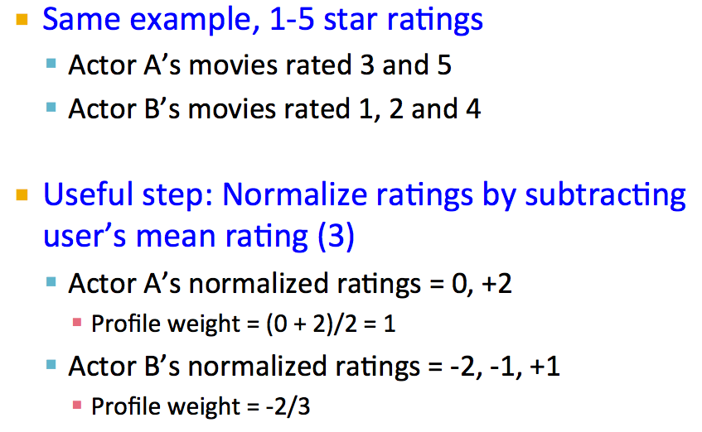
Content based recommendation:Ratings
http://infolab.stanford.edu/~ullman/mmds/ch9.pdf
27

Slide 28
Content based recommendation: Item Profiles
Documents: news articles, web pages, blogs
How to recommend users relevant document?
    Term … Feature
    Document … Item
Feature Discovery for documents
  The very famous TFIDF method
  Clean the documents (remove stop words)
  Calculate the TFIDF scores
  Choose top k or certain percentage or those above the threshold
http://infolab.stanford.edu/~ullman/mmds/ch9.pdf
28

Slide 29
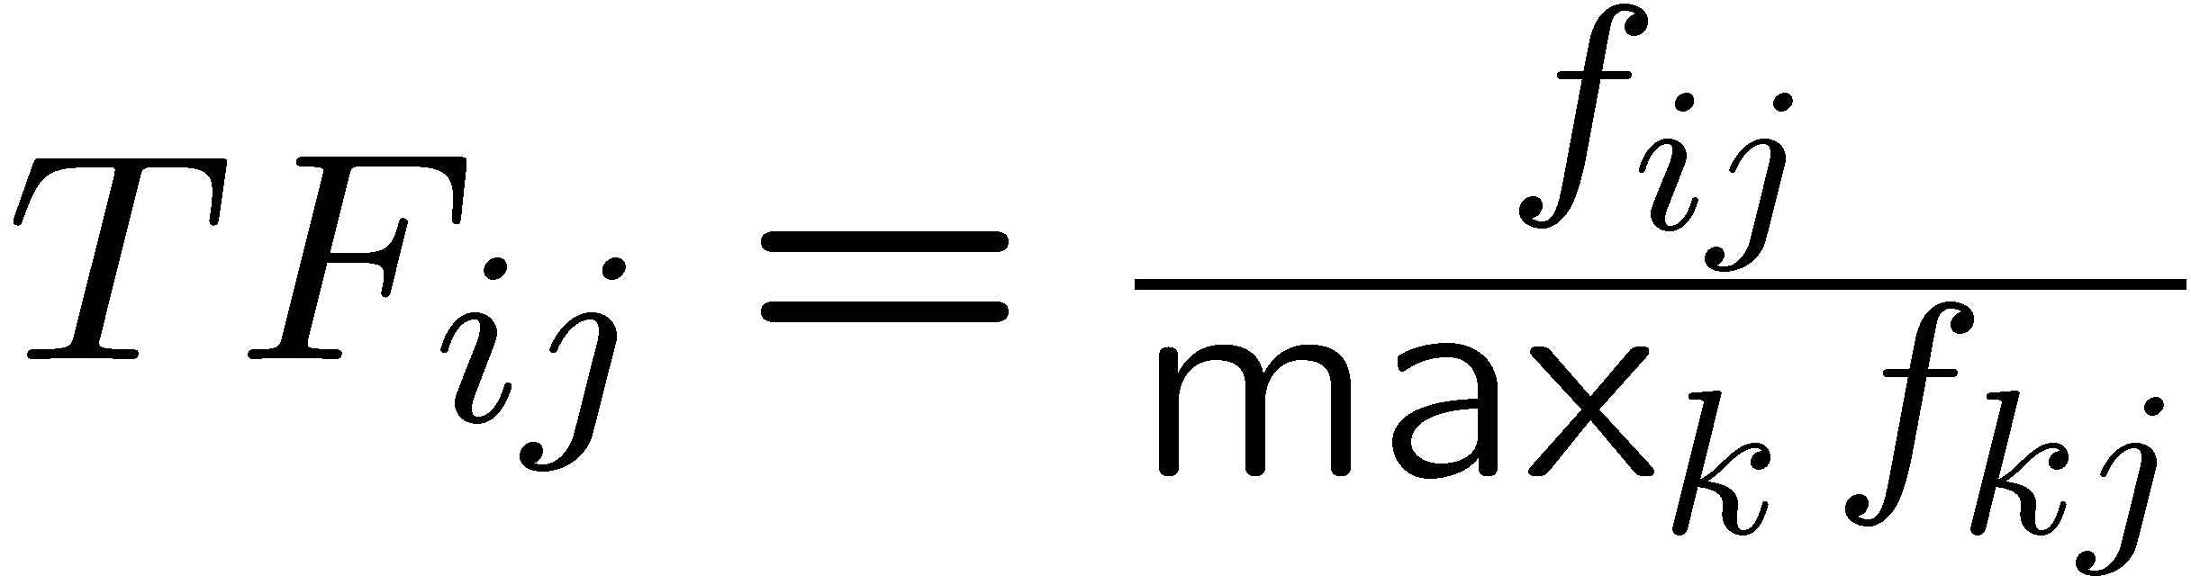
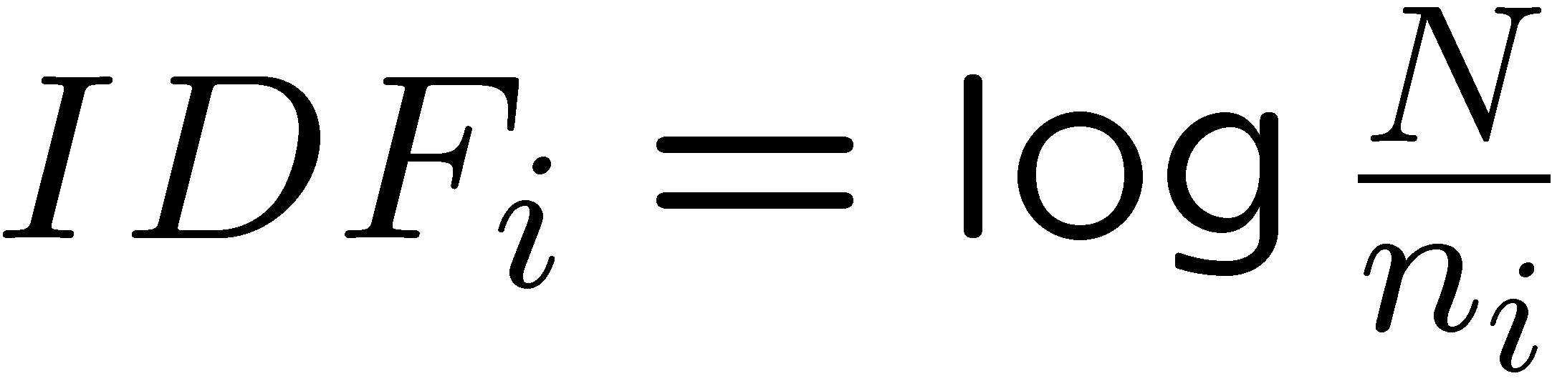
Sidenote: TF-IDF
f_{ij} = frequency of term (feature) i in doc (item) j
n_{i} = number of docs that mention term i
N = total number of docs
TF-IDF score: w_{ij} = TF_{ij} × IDF_{i}
Doc profile = set of words with highest TF-IDF scores, together with their scores
Note: we normalize TF
to discount for “longer”
documents

Slide 30
Content based recommendation: Item Profiles
Once we extract significant words for the documents
Similarity Between Documents
  Jaccard Similarity btw sets of words
  Cosine similarity btw document vectors
http://infolab.stanford.edu/~ullman/mmds/ch9.pdf
30

Slide 31
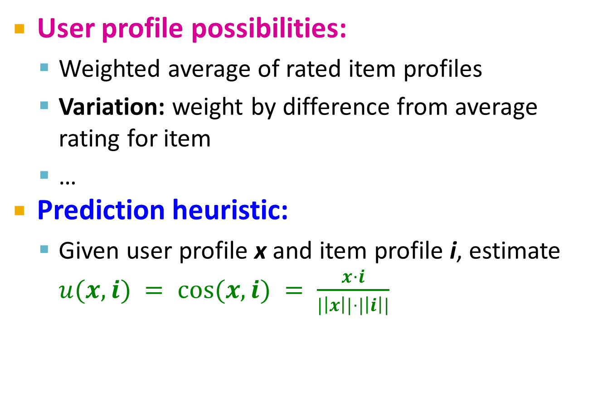
User Profiles and Prediction

Slide 32
Content based recommendation: Similarity of User and Item Profiles
Use Cosine similarity between user profile and the item profile
  The highest recommendations (lowest cosine distance) belong to the movies with lots of actors that appear in many of the movies the user has seen
  Ratings of the user will make better estimates
http://infolab.stanford.edu/~ullman/mmds/ch9.pdf
32

Slide 33
Content based recommendation: Seen as a Classification Problem
Use the item profiles that the user liked as training data
Build a classifier (like a decision tree)
Use the classifier to predict if the user will like another item
Better to use an ensemble of classifiers using different features and use voting to decide on the class
Need a classifier for each user which may be very expensive for case of many users
http://infolab.stanford.edu/~ullman/mmds/ch9.pdf
33

Slide 34
Pros: Content-based Approach
+: No need for data on other users
  No cold-start or sparsity problems
+: Able to recommend to users with
unique tastes
+: Able to recommend new & unpopular items
  No first-rater problem
+: Able to provide explanations
  Can provide explanations of recommended items by listing content-features that caused an item to be recommended

Slide 35
Cons: Content-based Approach
–: Finding the appropriate features is hard
  E.g., images, movies, music
–: Recommendations for new users
  How to build a user profile?
–: Overspecialization
  Never recommends items outside user’s
  content profile
  People might have multiple interests
  Unable to exploit quality judgments of other users

Slide 36
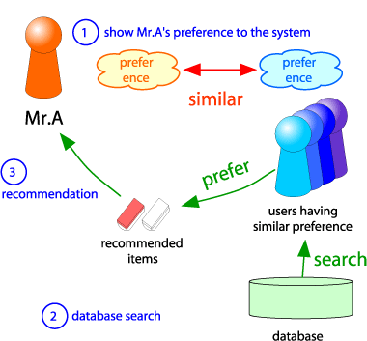
Collaborative Filtering
Consider user x
Find set N of other
users whose ratings
are “similar” to
x’s ratings
Estimate x’s ratings
based on ratings
of users in N
x
N

Slide 37
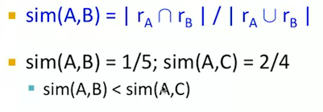
Collaborative Filtering
http://infolab.stanford.edu/~ullman/mmds/ch9.pdf
We need a similarity metric for the users
Which users are similar in the above figure?
How about Jaccard Similarity?
37

Slide 38
Collaborative Filtering
http://infolab.stanford.edu/~ullman/mmds/ch9.pdf
Should capture the intuition that Sim(A,B) > Sim(A,C)
User A and C have opposite views on movies
Jaccard distance is not good for the above case but can be used for boolean utility matrix (purchased, viewed, liked etc)
38

Slide 39
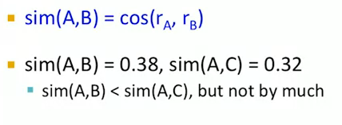
Collaborative Filtering
http://infolab.stanford.edu/~ullman/mmds/ch9.pdf
How about cosine similarity
39

Slide 40
Collaborative Filtering
http://infolab.stanford.edu/~ullman/mmds/ch9.pdf
Cosine similarity treats the unknown values as 0 which corresponds to a negative rating
Solution is to normalize using the row mean (Centered Cosine)
40

Slide 41
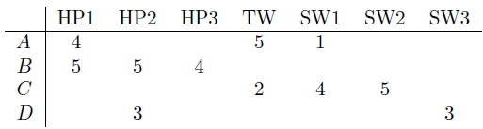
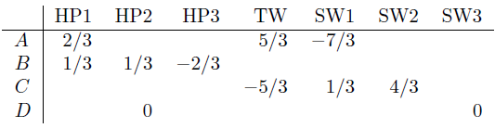

Collaborative Filtering
Solution is to normalize using the row mean (Centered Cosine)
http://infolab.stanford.edu/~ullman/mmds/ch9.pdf
41

Slide 42
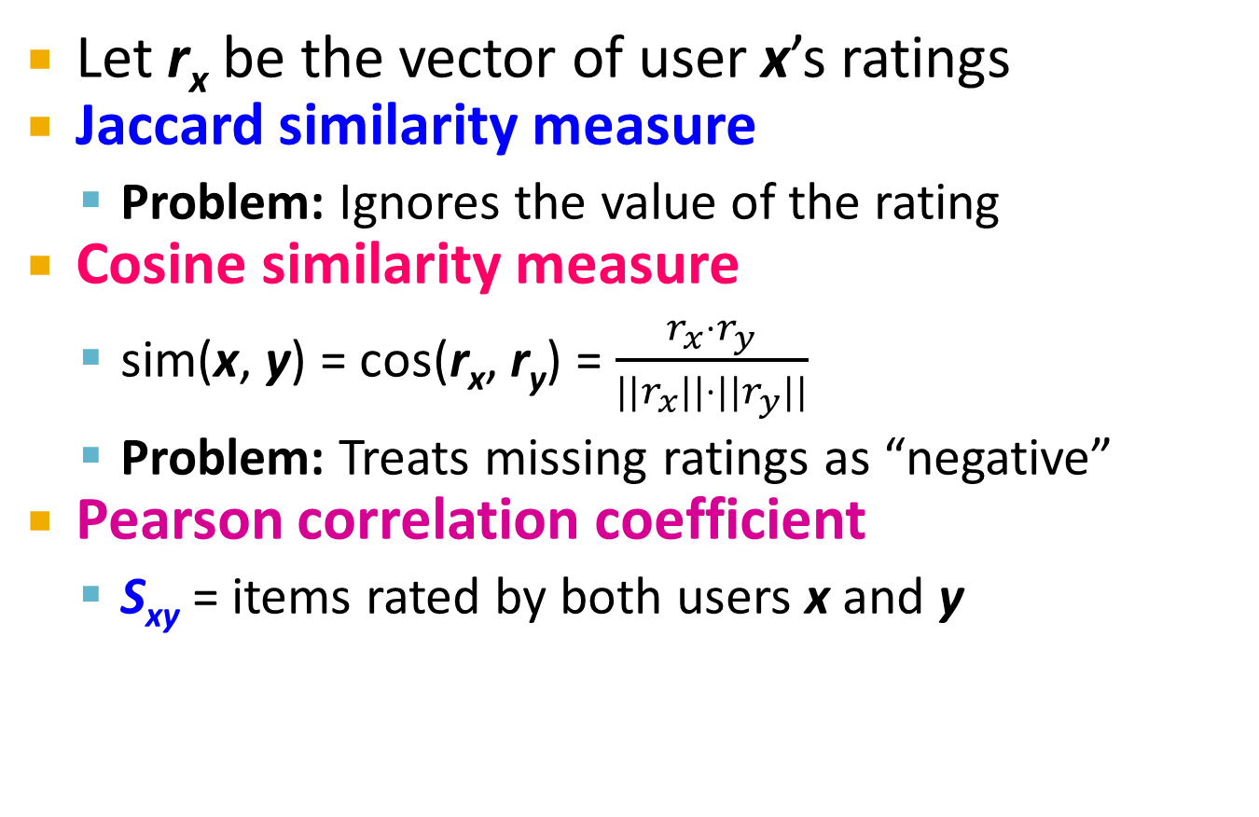
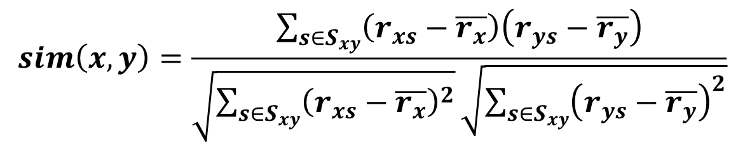
Finding “Similar” Users
r_{x} = [*, _, _, *, ***]
r_{y} = [*, _, **, **, _]
r_{x}, r_{y} as sets:
r_{x} = {1, 4, 5}
r_{y} = {1, 3, 4}
r_{x}, r_{y} as points:
r_{x} = {1, 0, 0, 1, 3}
r_{y} = {1, 0, 2, 2, 0}
r_{x}, r_{y} … avg.
rating of x, y
Notes:
-- Jaccard is not appropriate as we want to consider weights

Slide 43
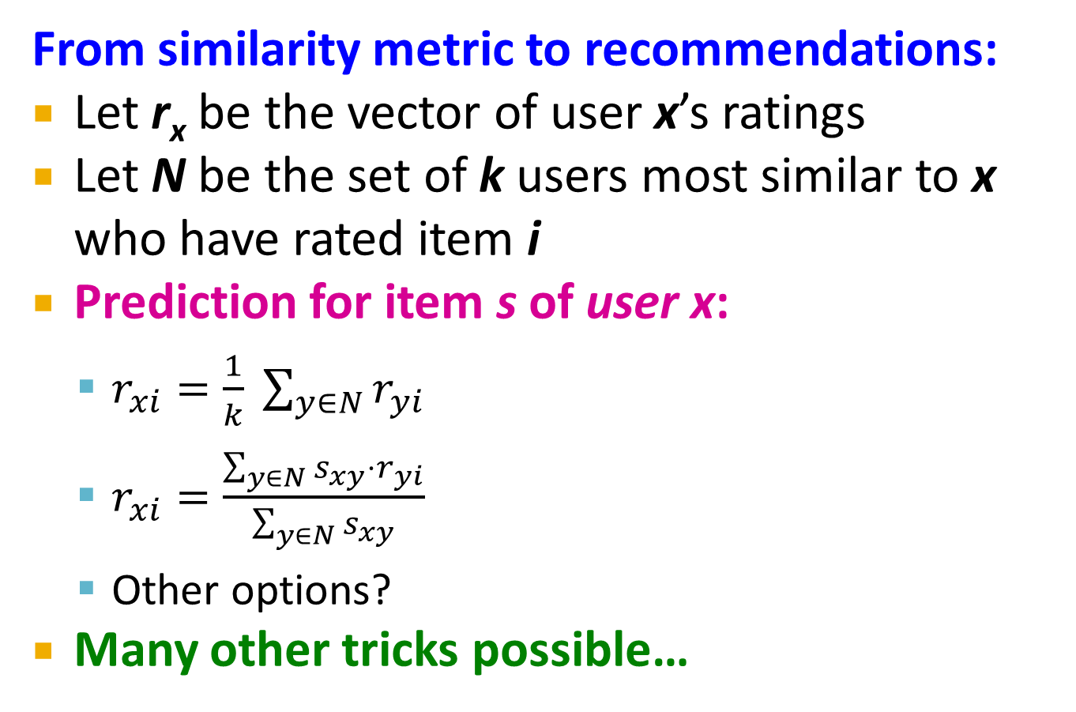
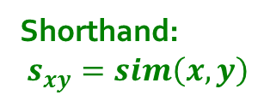
Rating Predictions

Slide 44
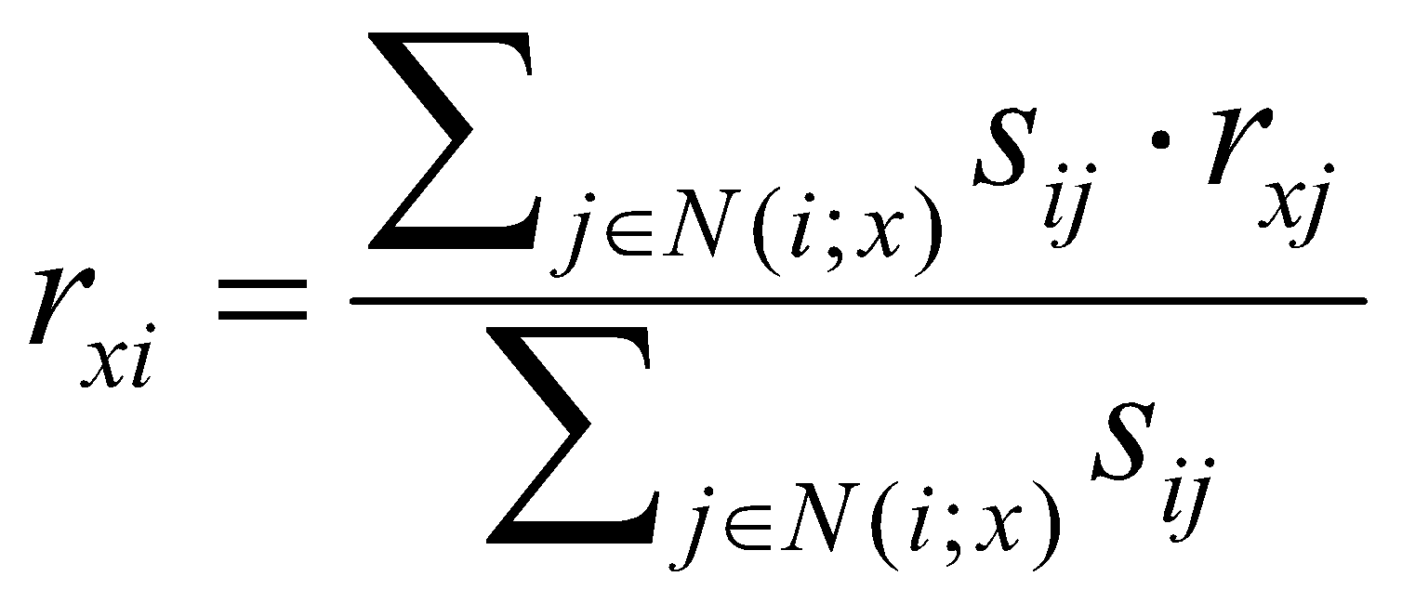
Item-Item Collaborative Filtering
So far: User-user collaborative filtering
Another view: Item-item
  For item i, find other similar items
  Estimate rating for item i based
  on ratings for similar items
  Can use same similarity metrics and
  prediction functions as in user-user model
s_{ij}… similarity of items i and j
r_{xj}…rating of user u on item j
N(i;x)… set items rated by x similar to i

Slide 45
Item-Item CF (|N|=2)
users
12 | 11 | 10 | 9 | 8 | 7 | 6 | 5 | 4 | 3 | 2 | 1
 | 4 |  | 5 |  |  | 5 |  |  | 3 |  | 1 | 1
3 | 1 | 2 |  |  | 4 |  |  | 4 | 5 |  |  | 2
 | 5 | 3 | 4 |  | 3 |  | 2 | 1 |  | 4 | 2 | 3
 | 2 |  |  | 4 |  |  | 5 |  | 4 | 2 |  | 4
5 | 2 |  |  |  |  | 2 | 4 | 3 | 4 |  |  | 5
 | 4 |  |  | 2 |  |  | 3 |  | 3 |  | 1 | 6
movies
- unknown rating
- rating between 1 to 5

Slide 46
Item-Item CF (|N|=2)
users
12 | 11 | 10 | 9 | 8 | 7 | 6 | 5 | 4 | 3 | 2 | 1
 | 4 |  | 5 |  |  | 5 | ? |  | 3 |  | 1 | 1
3 | 1 | 2 |  |  | 4 |  |  | 4 | 5 |  |  | 2
 | 5 | 3 | 4 |  | 3 |  | 2 | 1 |  | 4 | 2 | 3
 | 2 |  |  | 4 |  |  | 5 |  | 4 | 2 |  | 4
5 | 2 |  |  |  |  | 2 | 4 | 3 | 4 |  |  | 5
 | 4 |  |  | 2 |  |  | 3 |  | 3 |  | 1 | 6
movies
- estimate rating of movie 1 by user 5

Slide 47
Item-Item CF (|N|=2)
users
12 | 11 | 10 | 9 | 8 | 7 | 6 | 5 | 4 | 3 | 2 | 1
 | 4 |  | 5 |  |  | 5 | ? |  | 3 |  | 1 | 1
3 | 1 | 2 |  |  | 4 |  |  | 4 | 5 |  |  | 2
 | 5 | 3 | 4 |  | 3 |  | 2 | 1 |  | 4 | 2 | 3
 | 2 |  |  | 4 |  |  | 5 |  | 4 | 2 |  | 4
5 | 2 |  |  |  |  | 2 | 4 | 3 | 4 |  |  | 5
 | 4 |  |  | 2 |  |  | 3 |  | 3 |  | 1 | 6
sim(1,m)
1.00
-0.18
0.41
-0.10
-0.31
0.59
movies
Neighbor selection:
Identify movies similar to
movie 1, rated by user 5
Here we use Pearson correlation as similarity:
1) Subtract mean rating m_{i} from each movie i
m₁ = (1+3+5+5+4)/5 = 3.6
row 1: [-2.6, 0, -0.6, 0, 0, 1.4, 0, 0, 1.4, 0, 0.4, 0]
2) Compute cosine similarities between rows

Slide 48
Item-Item CF (|N|=2)
users
12 | 11 | 10 | 9 | 8 | 7 | 6 | 5 | 4 | 3 | 2 | 1
 | 4 |  | 5 |  |  | 5 | ? |  | 3 |  | 1 | 1
3 | 1 | 2 |  |  | 4 |  |  | 4 | 5 |  |  | 2
 | 5 | 3 | 4 |  | 3 |  | 2 | 1 |  | 4 | 2 | 3
 | 2 |  |  | 4 |  |  | 5 |  | 4 | 2 |  | 4
5 | 2 |  |  |  |  | 2 | 4 | 3 | 4 |  |  | 5
 | 4 |  |  | 2 |  |  | 3 |  | 3 |  | 1 | 6
sim(1,m)
1.00
-0.18
0.41
-0.10
-0.31
0.59
movies
Compute similarity weights:
s_{1,3}=0.41, s_{1,6}=0.59

Slide 49
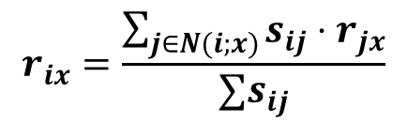
Item-Item CF (|N|=2)
users
12 | 11 | 10 | 9 | 8 | 7 | 6 | 5 | 4 | 3 | 2 | 1
 | 4 |  | 5 |  |  | 5 | 2.6 |  | 3 |  | 1 | 1
3 | 1 | 2 |  |  | 4 |  |  | 4 | 5 |  |  | 2
 | 5 | 3 | 4 |  | 3 |  | 2 | 1 |  | 4 | 2 | 3
 | 2 |  |  | 4 |  |  | 5 |  | 4 | 2 |  | 4
5 | 2 |  |  |  |  | 2 | 4 | 3 | 4 |  |  | 5
 | 4 |  |  | 2 |  |  | 3 |  | 3 |  | 1 | 6
movies
Predict by taking weighted average:
r_{1.5} = (0.41*2 + 0.59*3) / (0.41+0.59) = 2.6

Slide 50
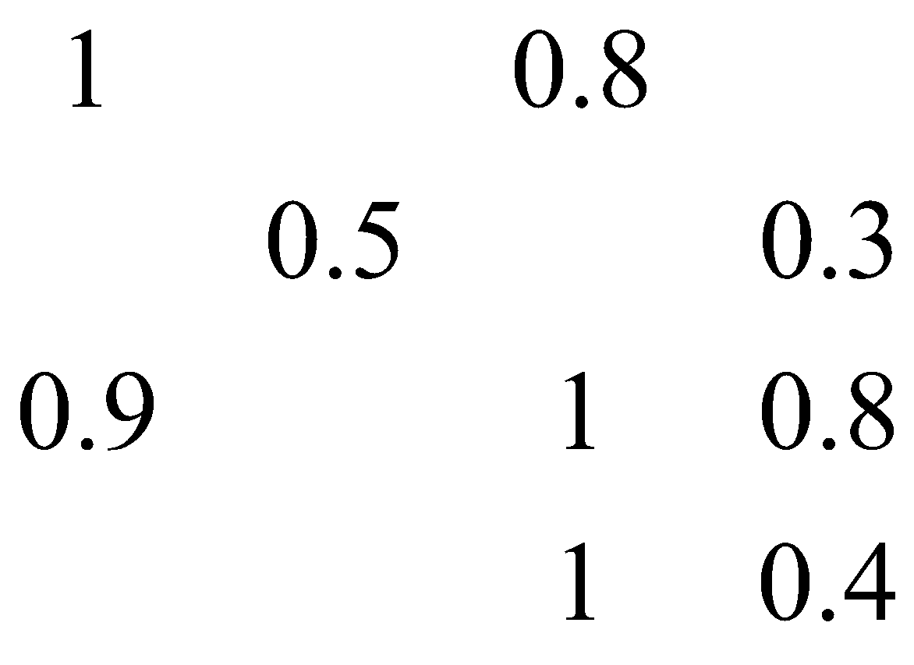
Item-Item vs. User-User
Avatar
LOTR
Matrix
Pirates
Alice
Bob
Carol
David
In practice, it has been observed that item-item often works better than user-user
Why? Items are simpler, users have multiple tastes
Notes:
There is a difference in the typical behavior of users and items, as it
pertains to similarity. Intuitively, items tend to be classifiable in simple
terms. For example, music tends to belong to a single genre. It is impossi-
ble, e.g., for a piece of music to be both 60’s rock and 1700’s baroque. On
the other hand, there are individuals who like both 60’s rock and 1700’s
baroque, and who buy examples of both types of music.
The consequence is that it is easier to discover items that are similar because they belong
to the same genre, than it is to detect that two users are similar because
they prefer one genre in common, while each also likes some genres that
the other doesn’t care for.

Slide 51
Pros/Cons of Collaborative Filtering
+ Works for any kind of item
  No feature selection needed
- Cold Start:
  Need enough users in the system to find a match
- Sparsity:
  The user/ratings matrix is sparse
  Hard to find users that have rated the same items
- First rater:
  Cannot recommend an item that has not been
  previously rated
  New items, Esoteric items
- Popularity bias: (Harry Potter Effect)
  Cannot recommend items to someone with
  unique taste
  Tends to recommend popular items

Slide 52
Hybrid Methods
Implement two or more different recommenders and combine predictions
  Perhaps using a linear model
Add content-based methods to
collaborative filtering
  Item profiles for new item problem
  Demographics to deal with new user problem

Slide 53
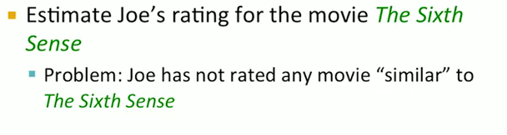
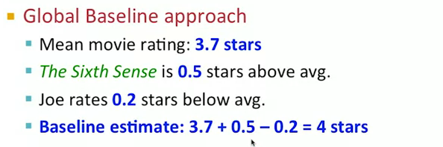
Hybrid Methods

Slide 54
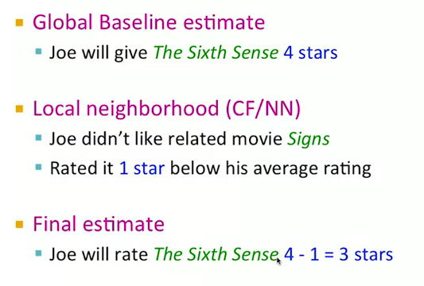
Hybrid Methods

Slide 55
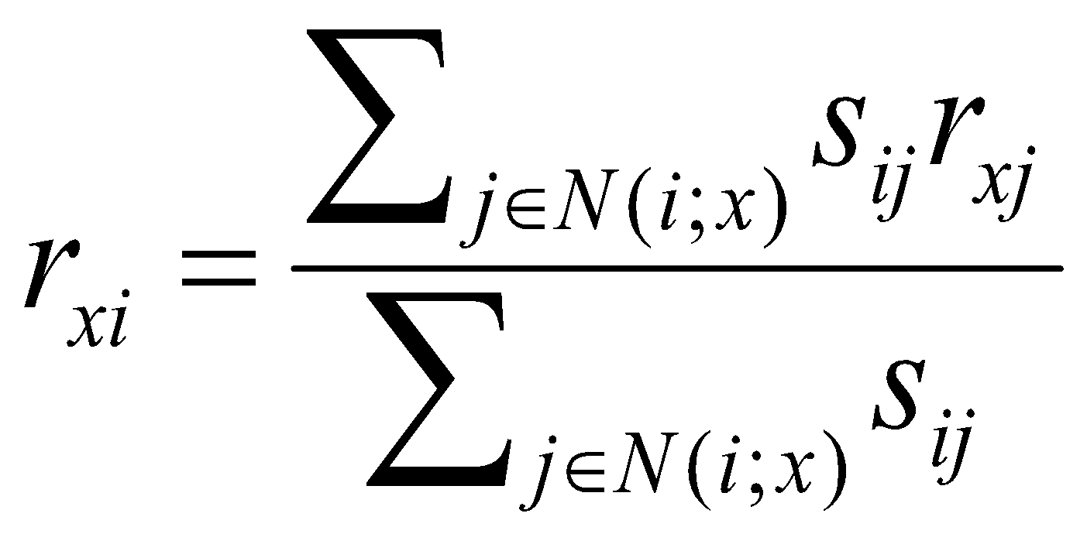

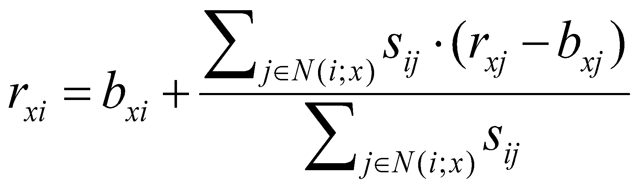

CF: Common Practice
Before:
Define similarity s_{ij} of items i and j
Select k nearest neighbors N(i; x)
  Items most similar to i, that were rated by x
Estimate rating r_{xi} as the weighted average:
μ = overall mean movie rating
b_{x} = rating deviation of user x
= (avg. rating of user x) – μ
b_{i} = rating deviation of movie i
baseline estimate for r_{xi}

Slide 56
Evaluation
movies
1 | 3 | 4
 | 3 | 5 |  |  | 5
 |  | 4 | 5 |  | 5
 |  | 3
 |  | 3
2 |  |  | 2 |  | 2
 |  |  |  | 5
 | 2 | 1 |  |  | 1
 | 3 |  |  | 3
1
users

Slide 57
Evaluation
movies
1 | 3 | 4
 | 3 | 5 |  |  | 5
 |  | 4 | 5 |  | 5
 |  | 3
 |  | 3
2 |  |  | ? |  | ?
 |  |  |  | ?
 | 2 | 1 |  |  | ?
 | 3 |  |  | ?
1
users
Test Data Set

Slide 58
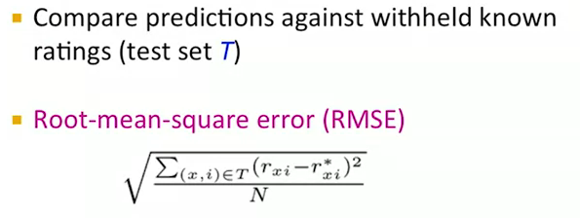
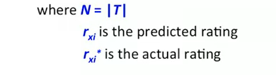
Evaluating Predictions

Slide 59
Problems with Error Measures
Narrow focus on accuracy sometimes
misses the point
  Prediction Diversity (Predict always Harry Poter)
  Prediction Context (Travelling)
  Order of predictions
In practice, we care only to predict high ratings:
  RMSE might penalize a method that does well
  for high ratings and badly for others

Slide 60
Evaluating Predictions
Alternative is to look at top-k precision among the withheld ratings of the user

Slide 61
Collaborative Filtering: Complexity
Expensive step is finding k most similar users: O(|U|)
Too expensive to do at runtime
  Could pre-compute
Naïve pre-computation takes time O(n ·|U|)
      U … set of users
How to do this?
  Clustering
  Locality Sensitive Hashing (LSH)
  Dimensionality reduction

Slide 62
Tip: Add Data
Leverage all the data
  Don’t try to reduce data size in an
  effort to make fancy algorithms work
  Simple methods on large data do best
Add more data
  e.g., add IMDB data on genres
More data beats better algorithms
http://anand.typepad.com/datawocky/2008/03/more-data-usual.html

Slide 63
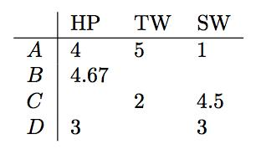
Recommendation Systems:
Solving the problem of sparsity
There are so many possible items
It is possible that users will not buy two items even if they are very similar
The utility matrix is very sparse
Solution is to cluster the items
Ratings are averaged
63

Slide 64
Recommendation Systems:
Solving the problem of sparsity
Now use the new utility matrix to cluster the users
You may do a few iterations
64

Slide 65
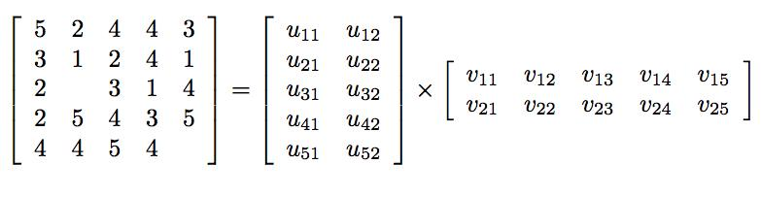
Recommendation Systems:
Dimensionality Reduction
Use a technique to singular value decomposition
UV-Decomposition tries to decompose M into U and V s.t. the UV closely approximates M
5x5 matrix is decomposed into 5x2 and 2x5 matrices
65

Slide 66
Recommendation Systems:
Dimensionality Reduction
UV Decomposition could be used to estimate the blank values in M
5x5 matrix is decomposed into 5x2 and 2x5 matrices
66

Slide 67
Recommendation Systems:
Dimensionality Reduction
How close is UV to M?
Root Mean Square Error is a good measure
  Try to find U and V that Minimizes the RMSE between UV and M
  Sum, over all nonblank entries in M the square of the difference between that entry and the corresponding entry in the product U V
67

Slide 68
Recommendation Systems:
Dimensionality Reduction
How to find U and V for M?
Start from a random U and V, and do incremental adjustments to U and V to minimize RMSE
May stuck in local minima therefore try different U and V, and different values
68

